Slide 1

Power BI Track
Cairo Branch
Examination System
May 2024-Sep. 2024

Slide 2
Team Members
Ahmed Ahmed Khamis Omar Emad Eldeen
Nader Elsayed
Ahmed Ashraf
Ahmed Farahat

Slide 3
Agenda
1-ERD 2-Database Diagram
3-Stored Procedures
4-SSRS Reports
5-Dashboards screenshots
6-Website

Slide 4
1-ERD

Slide 5
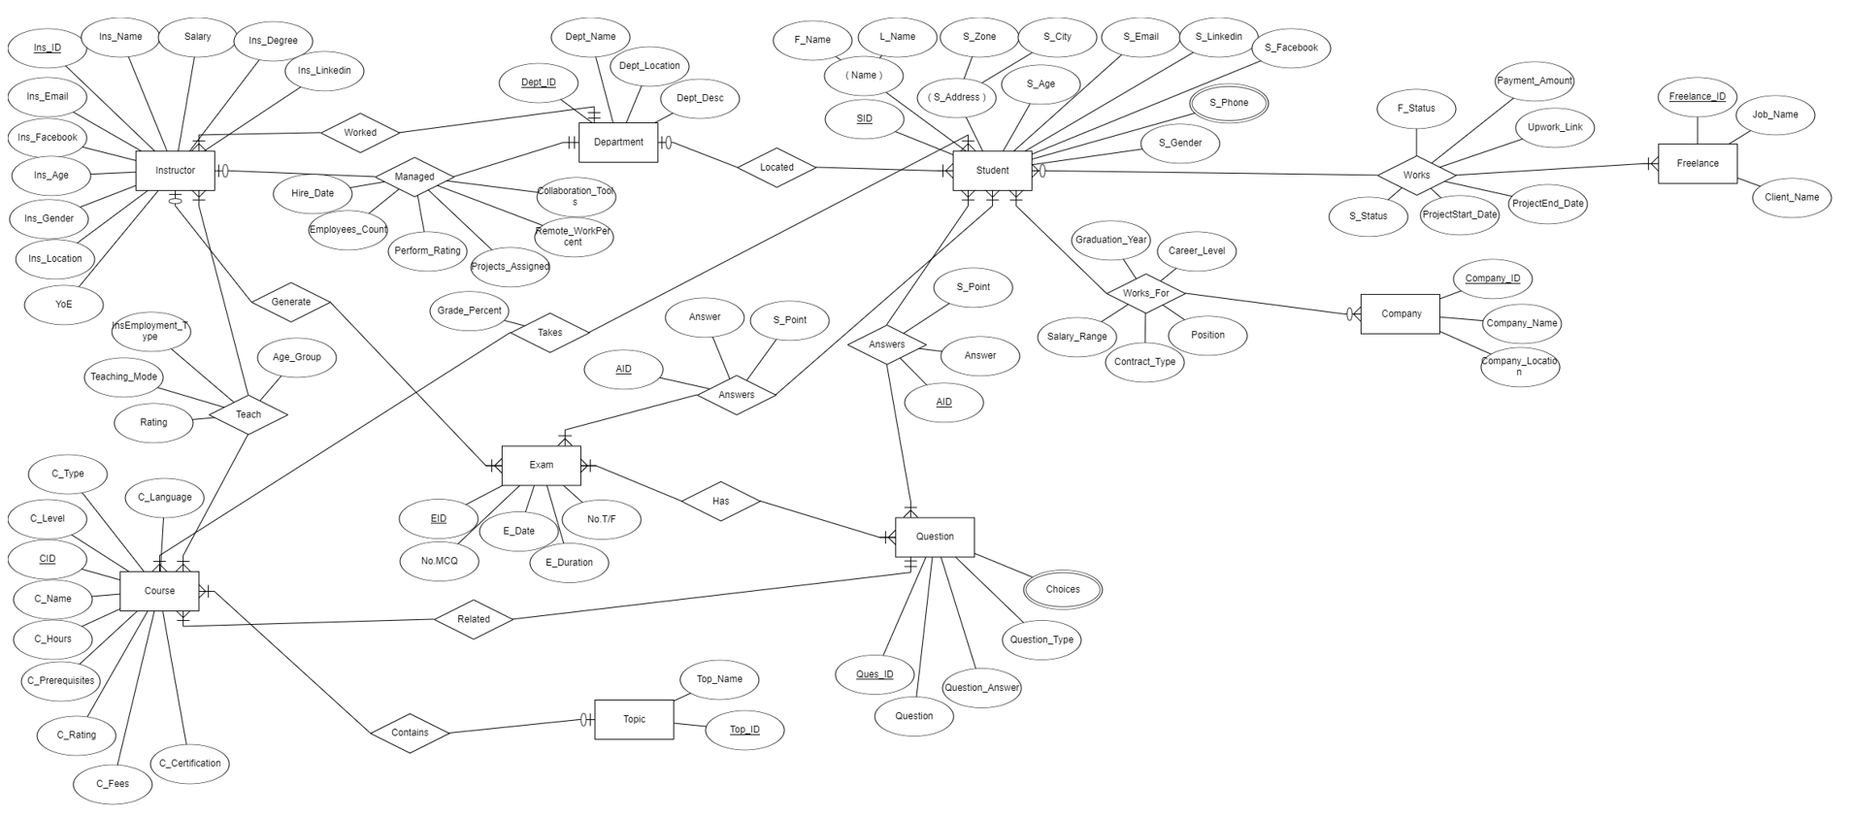
ERD

Slide 6
2-Database Diagram

Slide 7
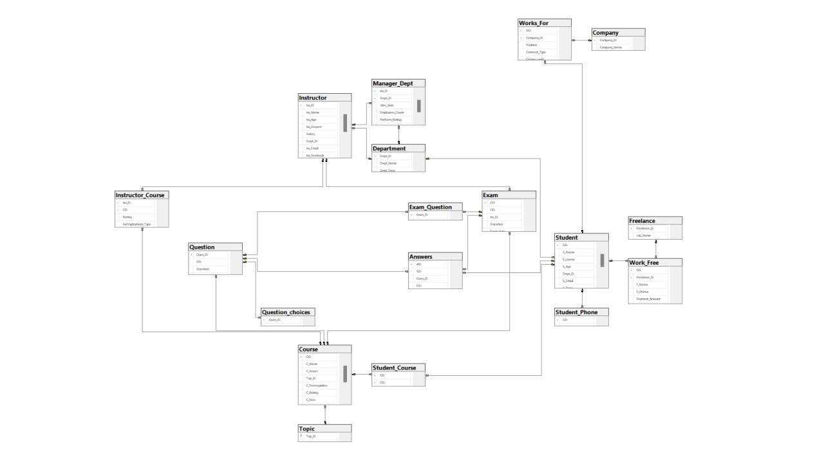
Database Diagram

Slide 8
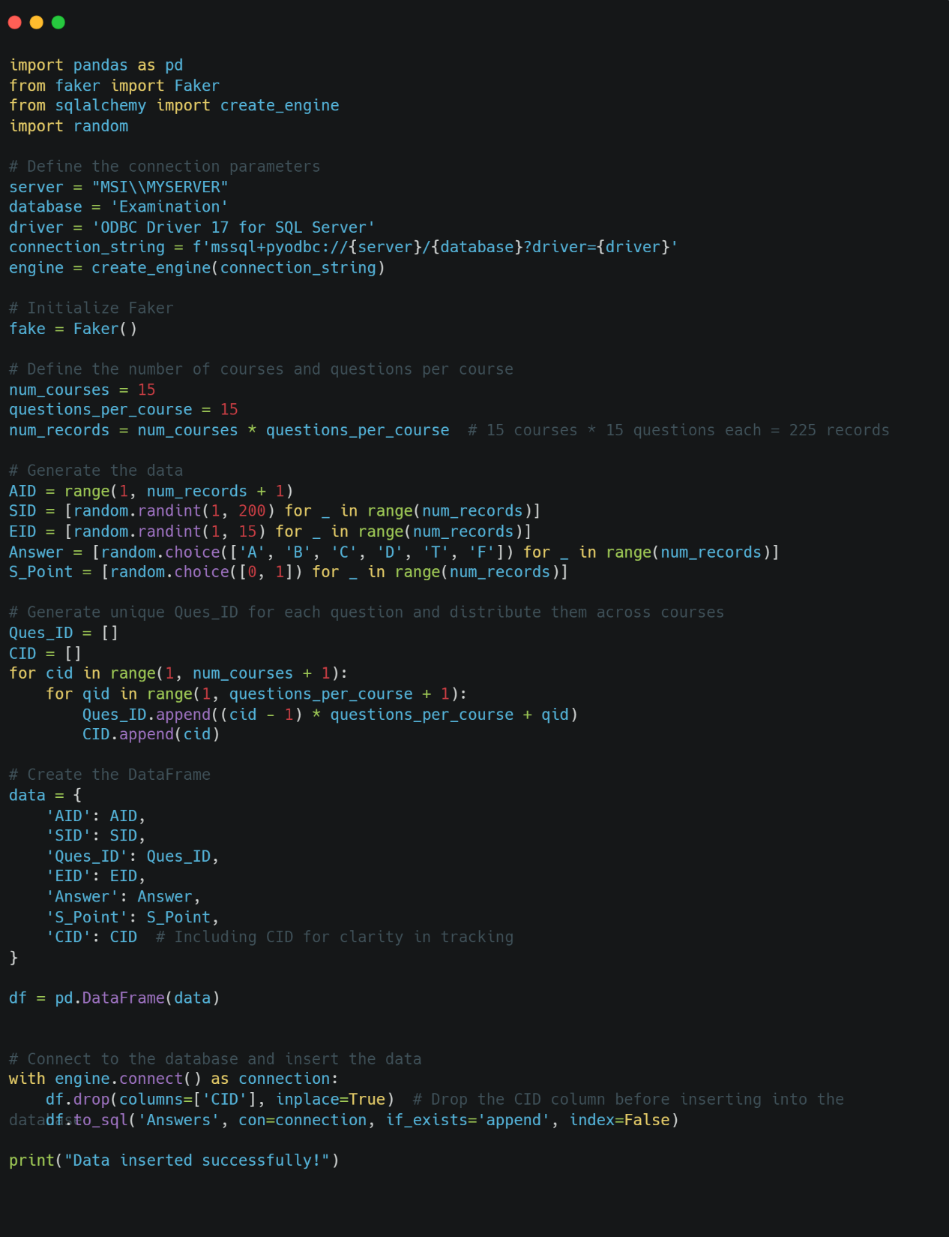
Generating Data Using Python (Faker Library)

Slide 9
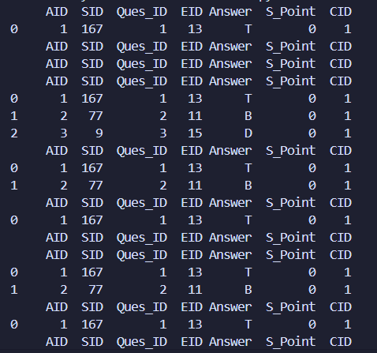
Generated Data Using Python (Faker Library)

Slide 10
3-Stored Procedures

Slide 11
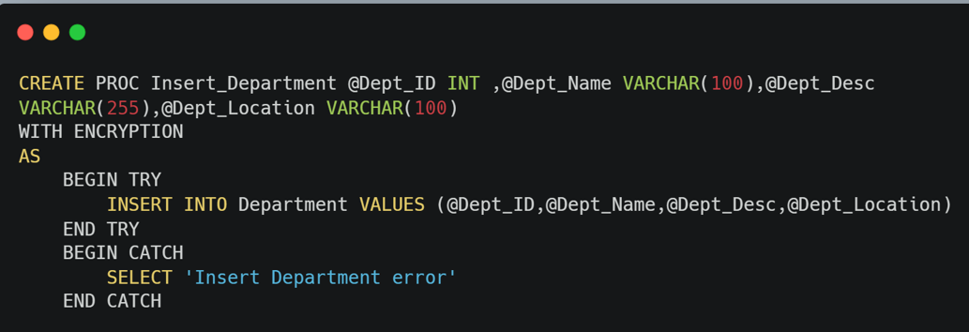
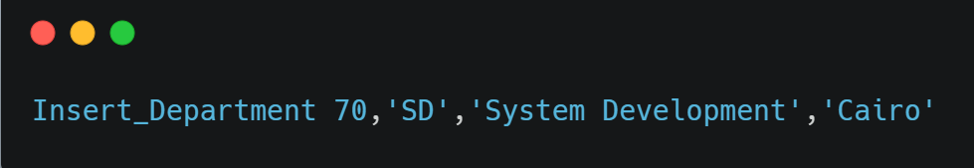
Insert Department
Input :
Dept_ID – Dept_Name – Dept_Desc – Dept_Location.
Process :
It takes these parameters in order to insert a new Department.
Output : It will insert new data to the Department table

Slide 12
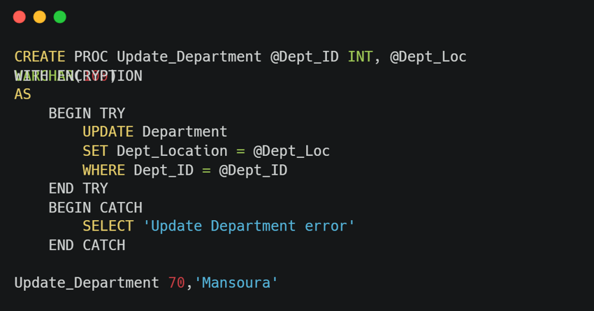
Update Department
Input :
Dept_ID – Dept_Loc.
Process :
It takes these parameters in order to update these columns.
Output : It will update the Department table.

Slide 13
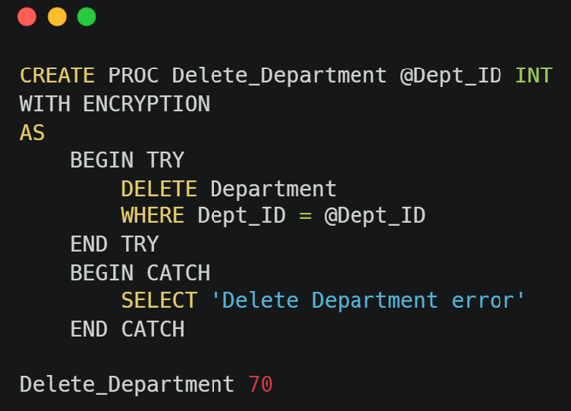
Delete Department
Input :
Dept_ID .
Process :
It takes Deparment ID and delete it .
Output : It Deletes a department based on the department ID .

Slide 14
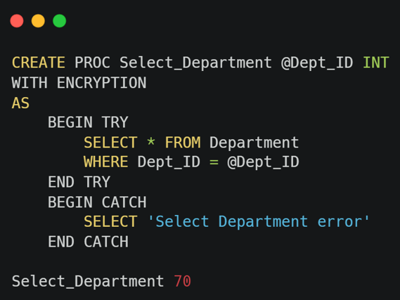
Select Department
Input :
Dept_ID .
Process :
It takes Deparment ID and SELECT it .
Output : Retrieves a department's details based on the department ID.

Slide 15
Generating Exams
Input:
Number of True/False
Number of Multiple Choice questions
Course-Name.
Process :
Generate exam by entering an exam record in the exam table
selecting random questions by using these inputs.
Output :
Generate the exam ID and inserts it with its duration in the Exam table
Shows the questions and choices of the generated exam.

Slide 16
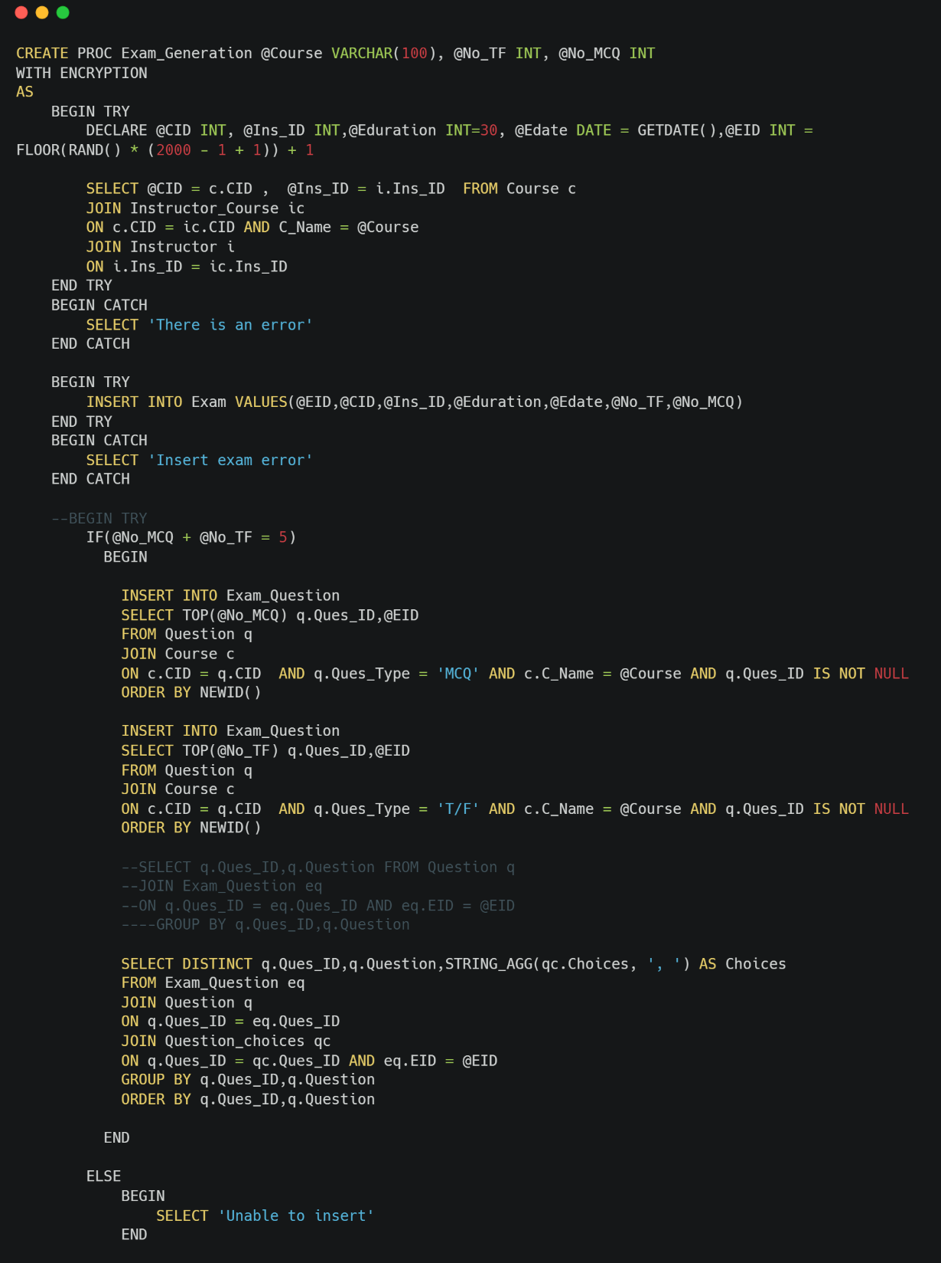
Generating Exams Code

Slide 17
Answering Exams
Input :
Exam ID – Student ID – Question ID – Answer.
Process :
Entering an answer record in the Answers table.
Output :
Student's answers will be recorded in the database.

Slide 18
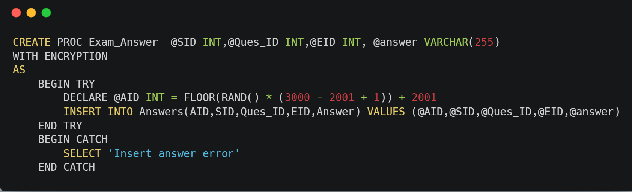
Answering Exams Code

Slide 19
Correcting Exams
Input :
Exam ID – Student ID.
Process :
Gets each Question ID with its grade, model answer and the student’s answer then compares them
Calculates the total points earned by the student
Updates the student's grade percentage in the relevant course.
Output : Inserts the student grade on each answer and mark the exam as corrected.

Slide 20
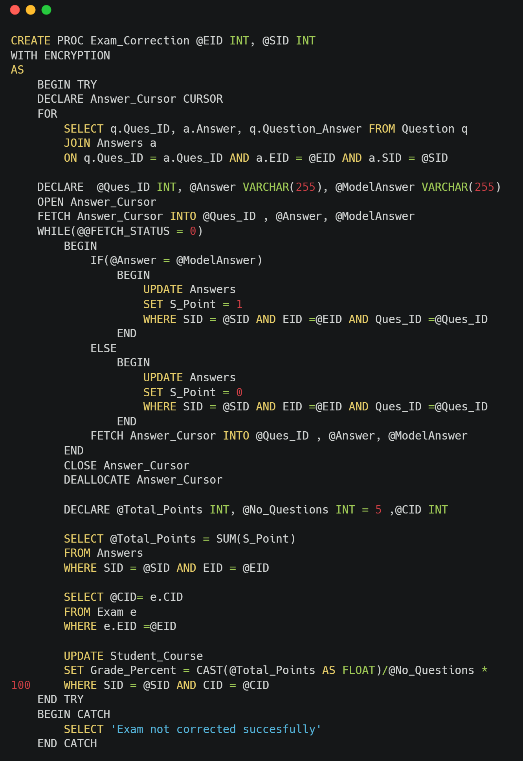
Correcting Exams Code

Slide 21
4-SSRS Reports

Slide 22
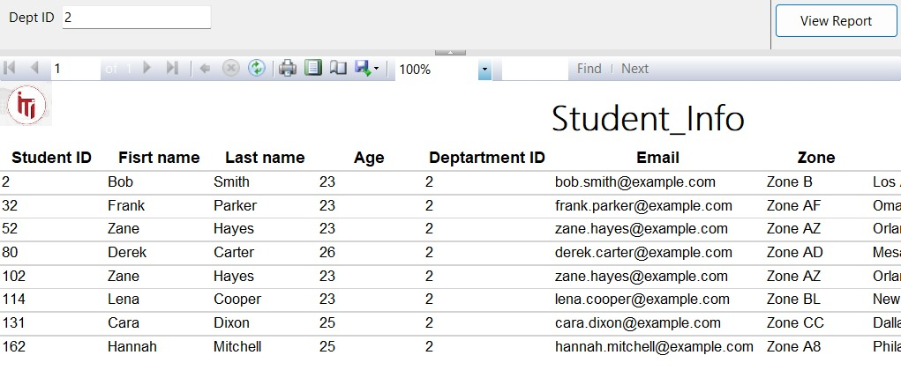
Report 1
Returns the students information
according to Department No parameter.

Slide 23
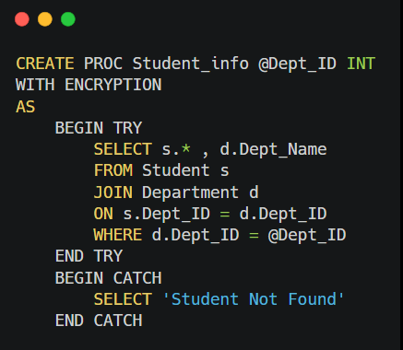
Report 1 Stored Procedures

Slide 24
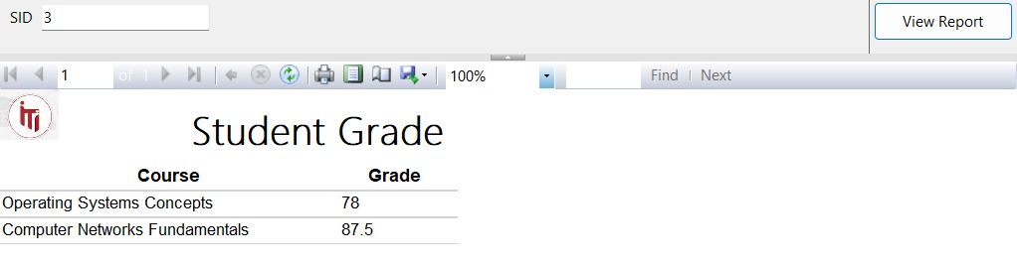
Report 2
Takes the student ID and returns
the grades of the student in all courses %

Slide 25
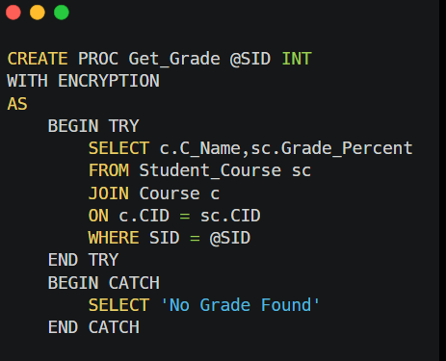
Report 2 Stored Procedures

Slide 26
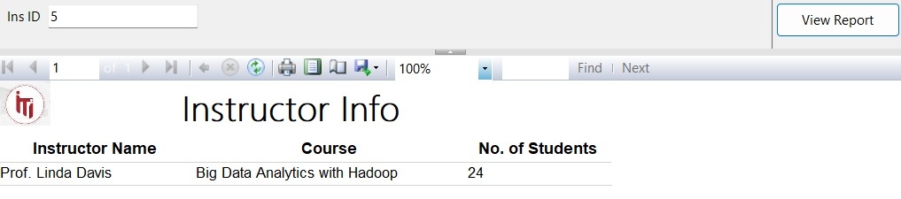
Report 3
Takes the instructor ID and returns
the name of the courses that he teaches
and the number of student per course.

Slide 27
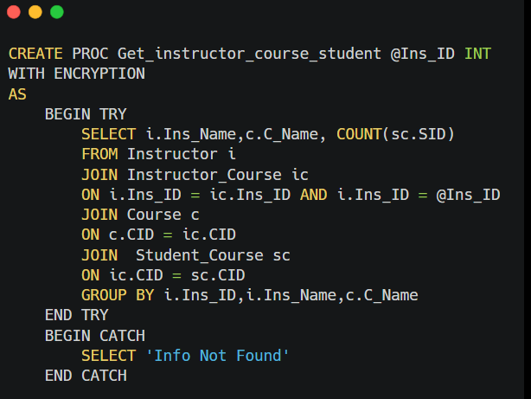
Report 3 Stored Procedures

Slide 28
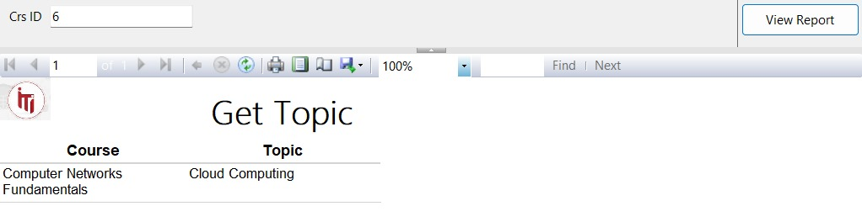
Report 4
Takes course ID and returns its topics.

Slide 29
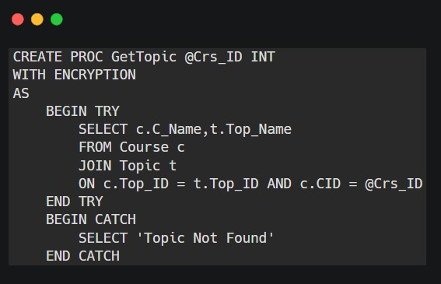
Report 4 Stored Procedures

Slide 30
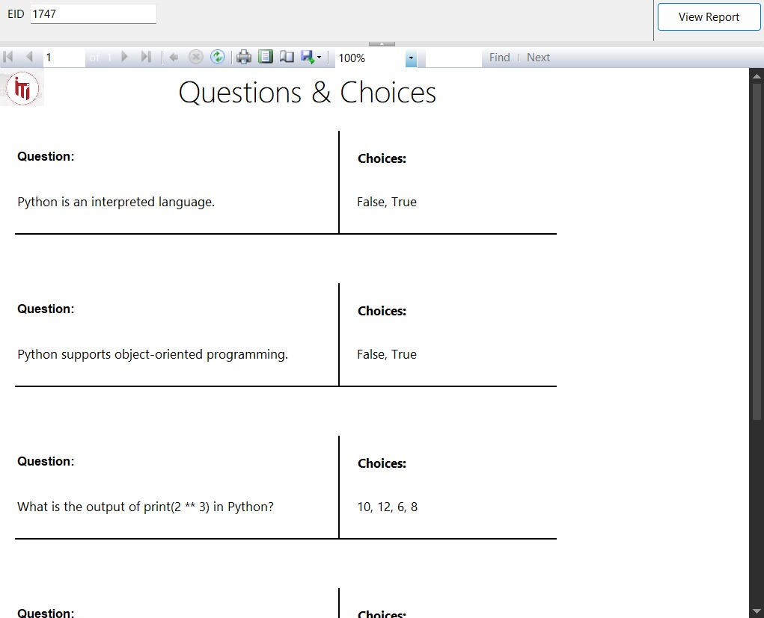
Report 5
Takes exam number and returns the Questions in it and choices.

Slide 31
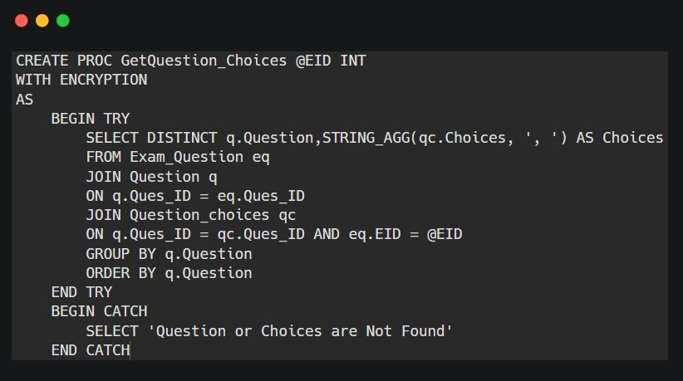
Report 5 Stored Procedures

Slide 32
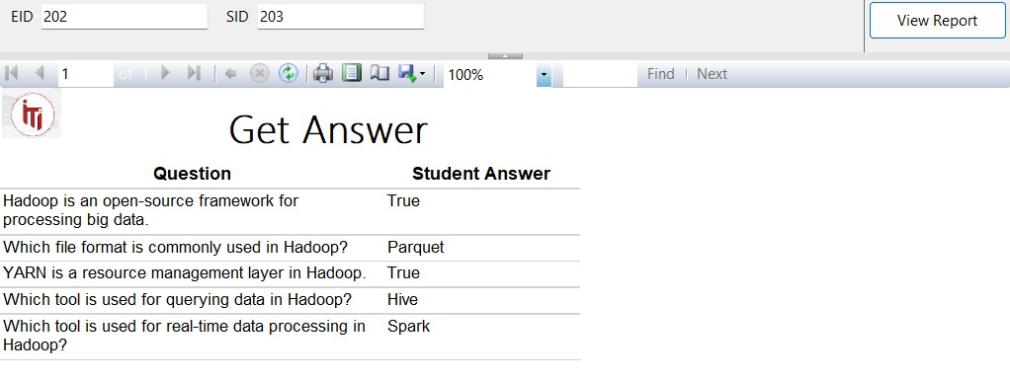
Report 6
Takes exam ID and the student ID then
returns the Questions in this exam with the student answers.

Slide 33
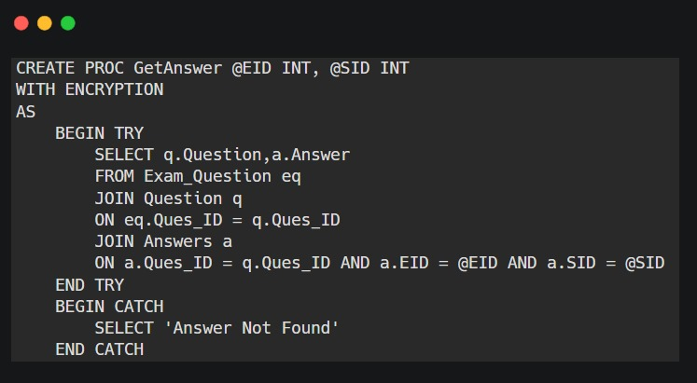
Report 6 Stored Procedures

Slide 34
5-Dashboards screenshots

Slide 35
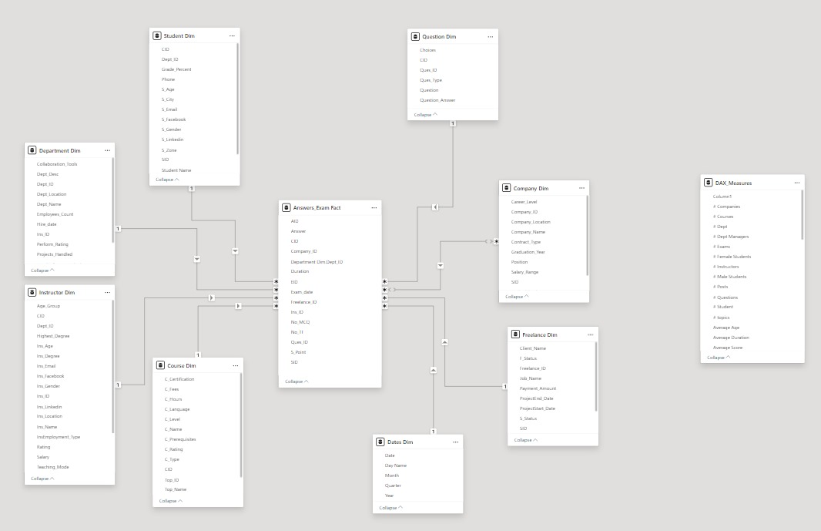
Modeling (Star Scheme)

Slide 36

Home Page Dashboard

Slide 37
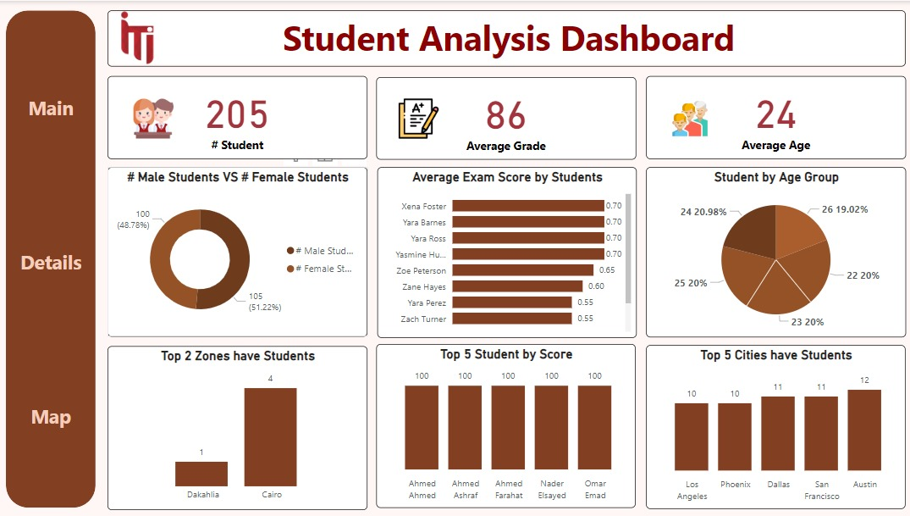
Student Dashboard

Slide 38
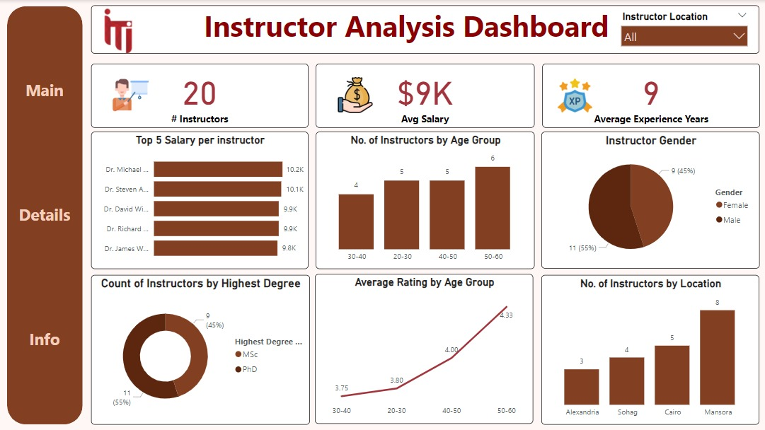
Instructor Dashboard

Slide 39
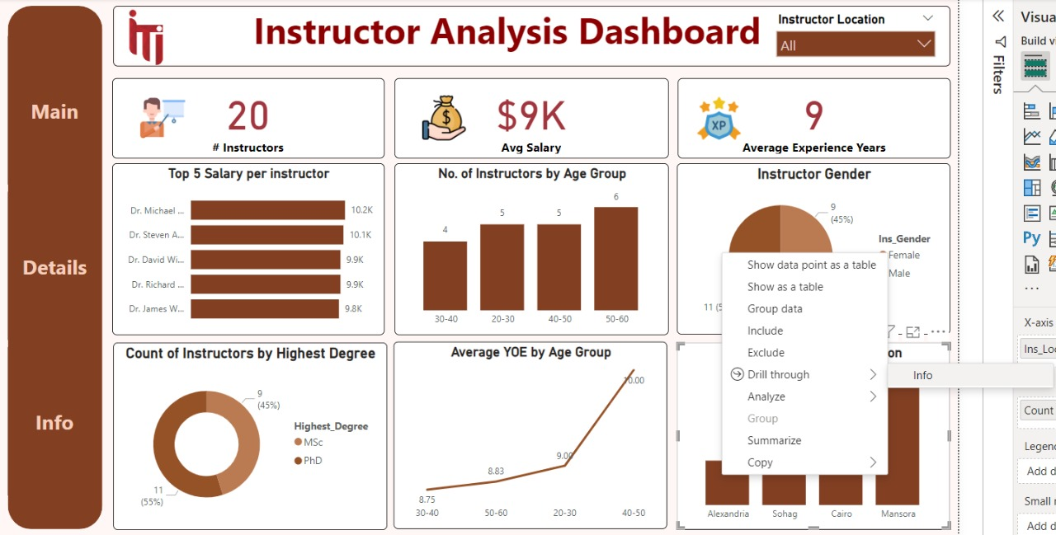
Dashboard Drill-through

Slide 40
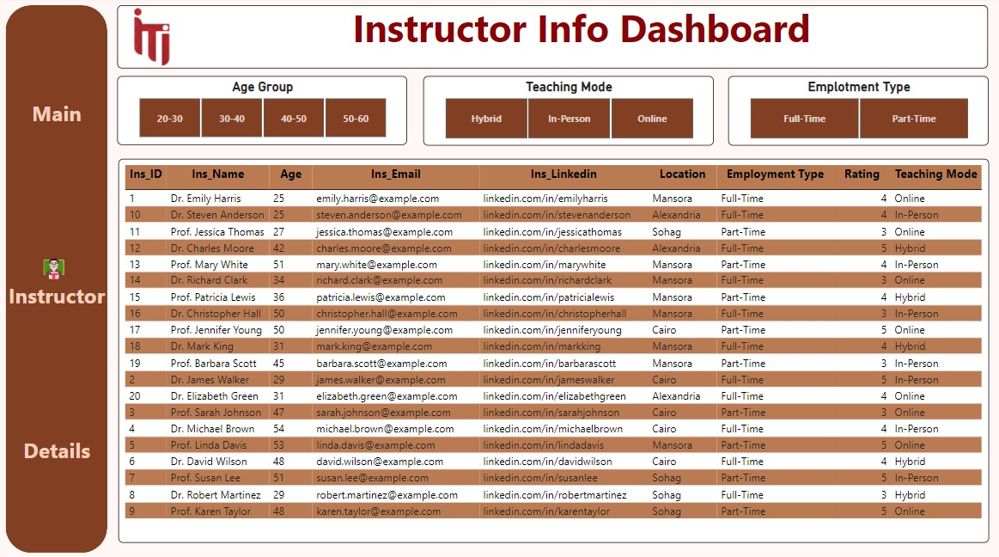
Dashboard Drill-through

Slide 41
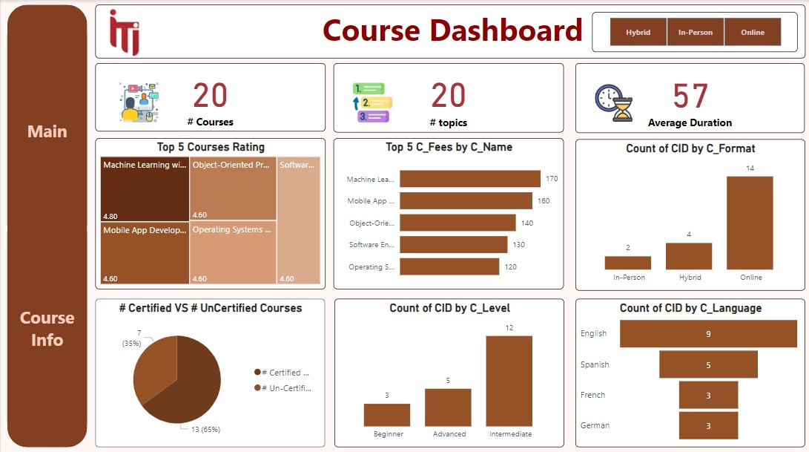
Course Dashboard

Slide 42
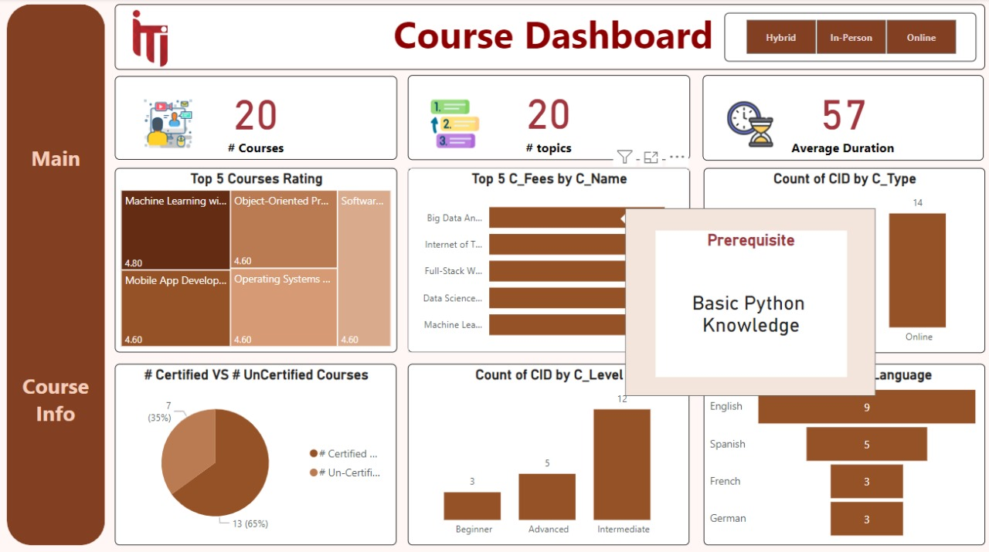
Course Dashboard With Tooltip

Slide 43
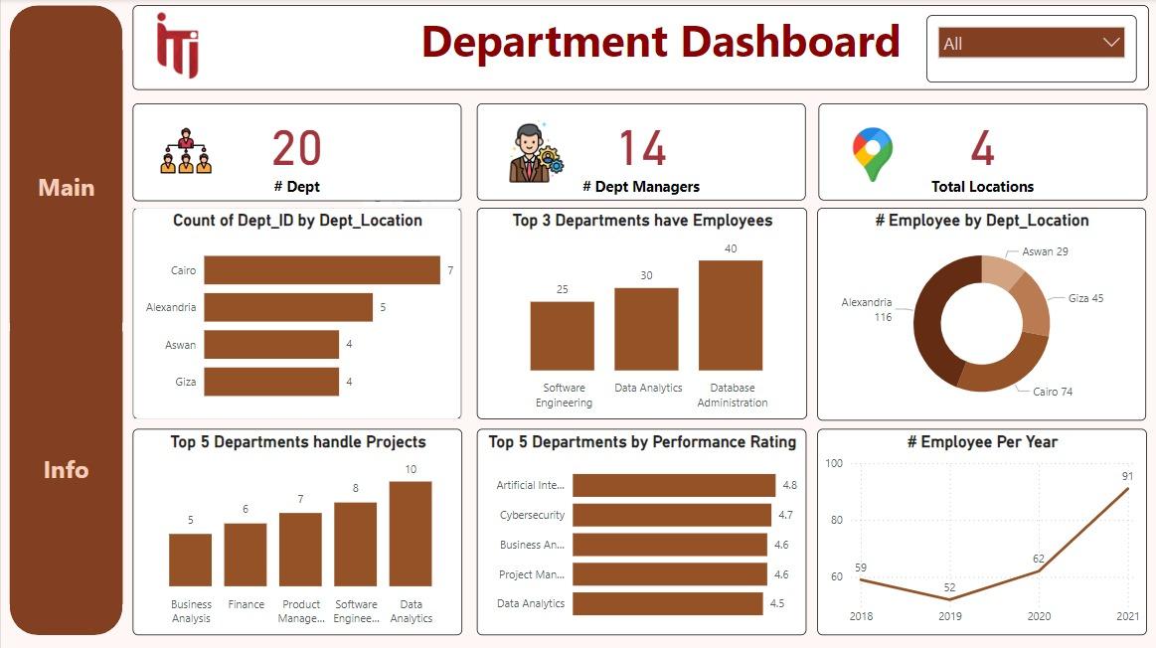
Department Dashboard

Slide 44
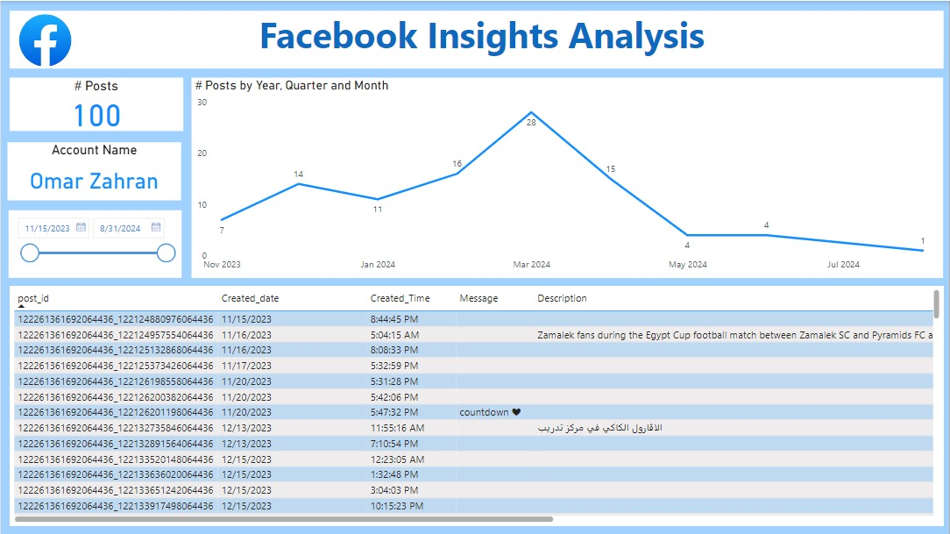
Facebook Dashboard

Slide 45
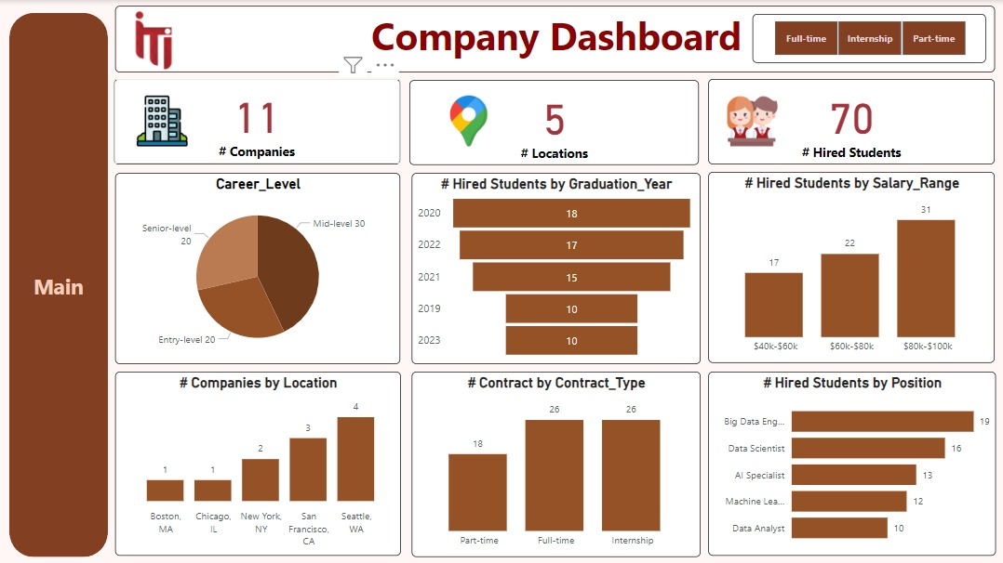
Company Dashboard

Slide 46
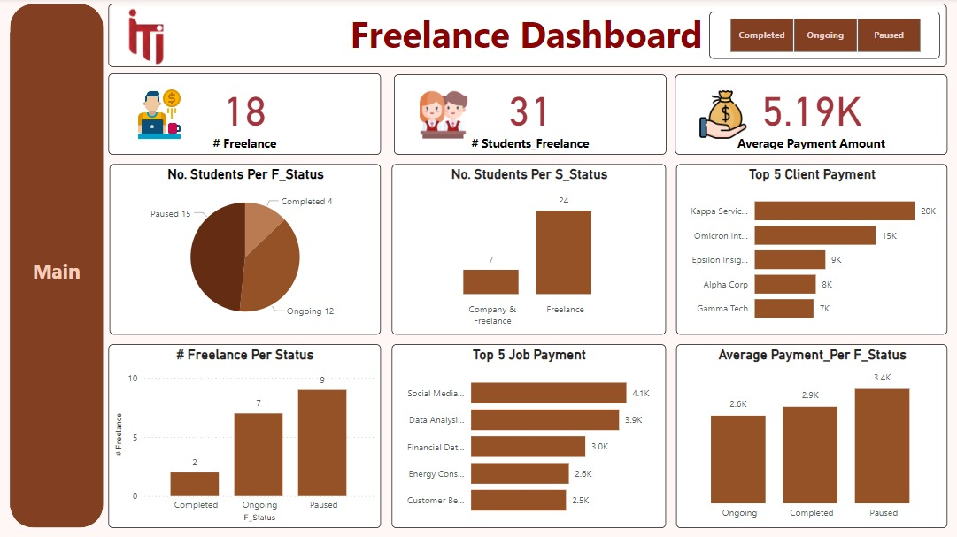
Freelance Dashboard

Slide 47
6-Website

Slide 48
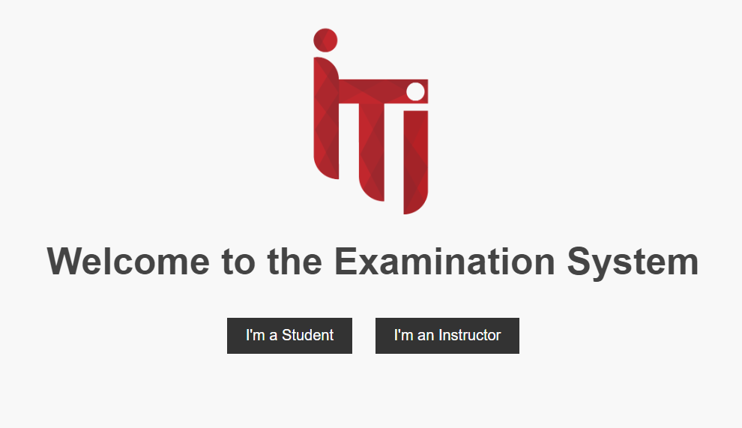
Home Page

Slide 49
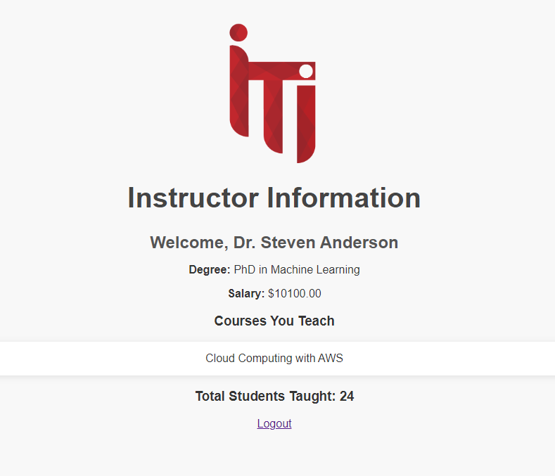
Instructor Page

Slide 50
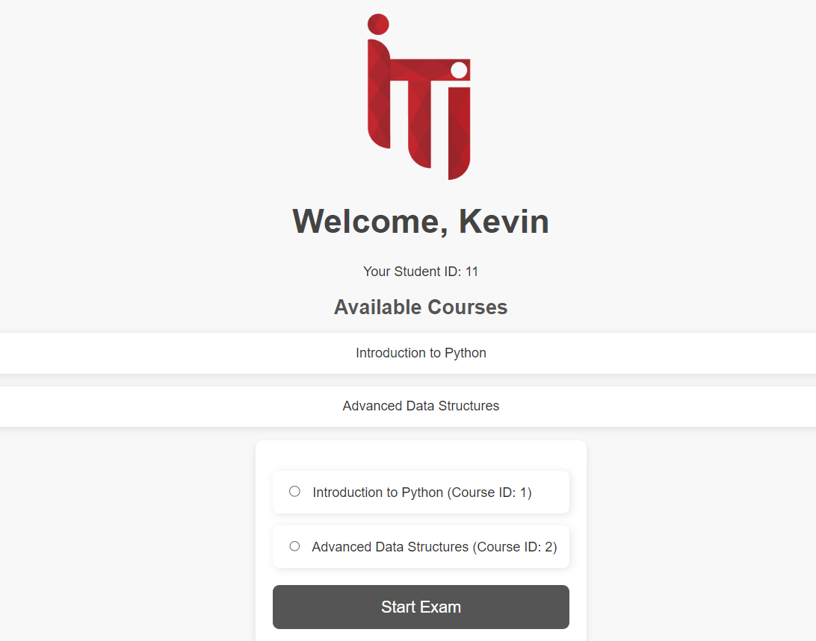
Student Page

Slide 51
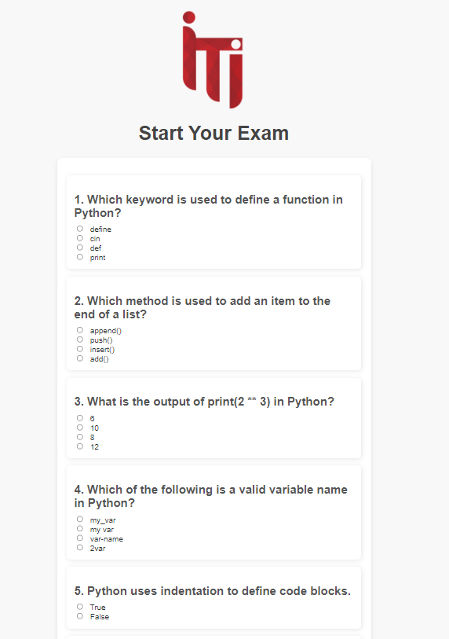
Exam Page

Slide 52
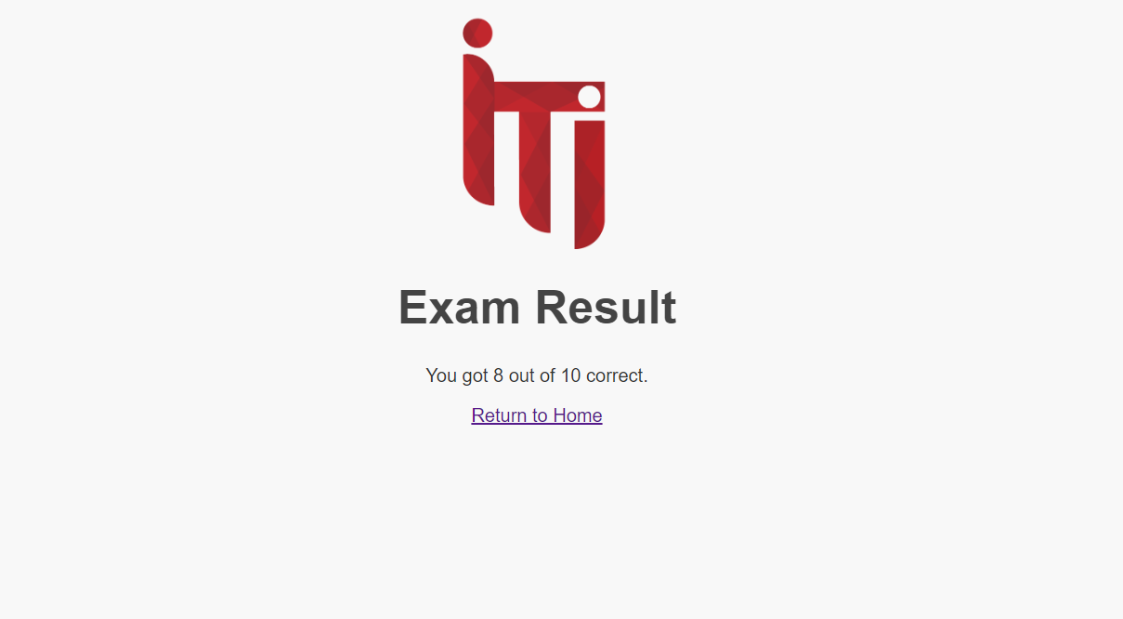
Student Result Page

Slide 53
Thank you.

